Slide 1
Densest Subgraph Discovery on the GPU
Hunter Gareau Thesis Defense

Slide 2
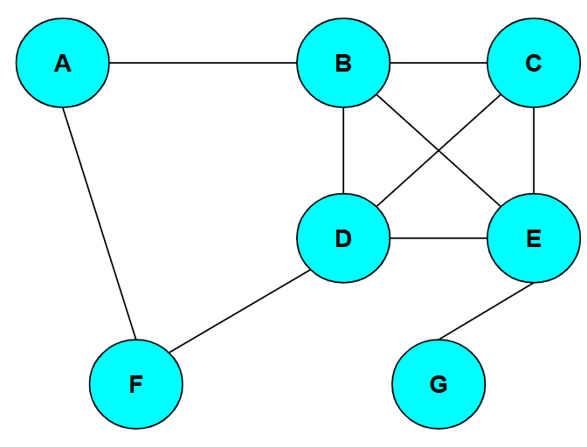
Graphs and Graph Mining
Graphs are a way of representing connections and relationships in data subjects.
They are composed of vertices and edges.
They can represent data from social networks to neural networks to power grids.
The analyzation of graphs to find patterns and information is called Graph Mining.

Slide 3
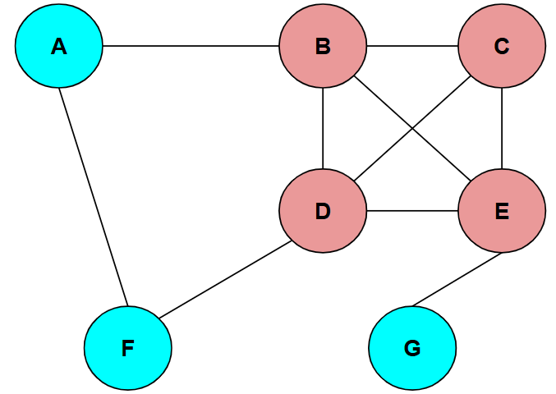
Densest Subgraph Discovery Problem
One fundamental Graph Mining problem is the Densest Subgraph Discovery Problem (DSD).
Edge density is the ratio of edges to vertices in a given graph.
The DSD aims to find the subgraph of highest density in a given graph.
The densest subgraph is a useful piece of information to have.

Slide 4
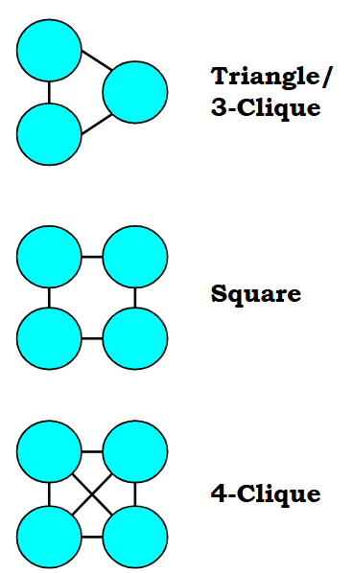
Cliques, Motifs, and Clique Density
Motifs are small subgraphs of a specific edge layout (such as triangles, squares, 4-paths, etc.), which are useful for examining more patterns and types of connections.
Cliques are a specific type of motif, where every vertex in the miniature subgraph is connected to one another.
Motif/Clique density is the ratio of motif or clique instances to the number of vertices in a subgraph.

Slide 5
Parallel Programming
Many solutions to the DSD exist, however they are serialized algorithms which get taxing quickly for Graph Mining programs when handling vertices and edges one at a time in large graphs/data sets.
By running in parallel, many vertices or edges can all be handled at once and cut down on runtime.
Serialized programs run entirely on the CPU (Central Processing Unit), but parallel programs often utilize the GPU (Graphics Processing Unit).

Slide 6
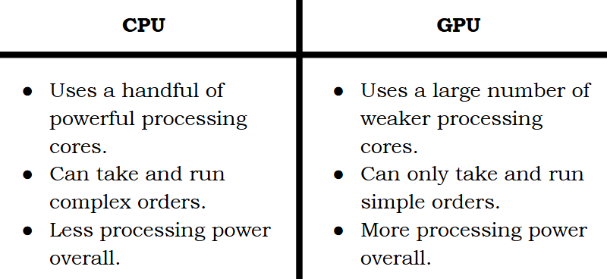

Slide 7
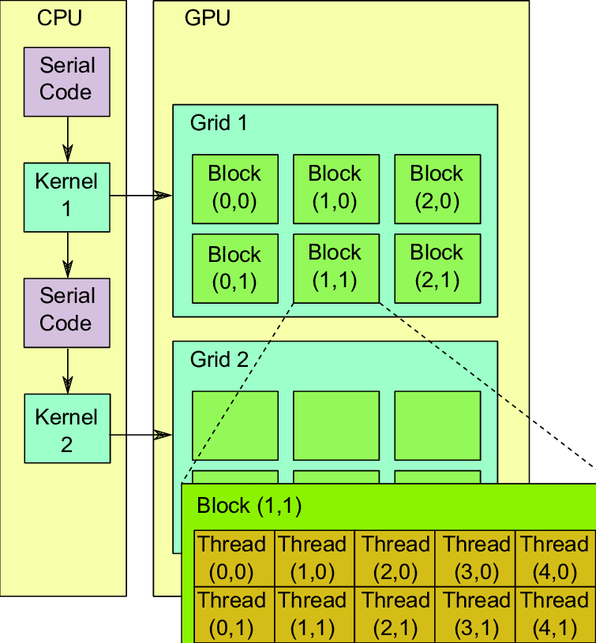
GPU Structure
It is important to understand the basic structure of the GPU to use it effectively.
Processes and commands are run on Threads (a unit of execution).
Threads are a hierarchal structure, and data is more costly to share between levels.
32 threads make up a Warp. The instructions are the same between threads in a warp.
Some number of warps make up a Block (the number depends on the GPU).
Final level is Grids, made up by blocks. When a kernel (parallel process) is launched, it is mapped to the processors of a grid.

Slide 8
CUDA by NVIDIA
Writing a program entirely in the simple language available to the GPU would be extremely difficult.
CUDA (Compute Unified Device Architecture) is a tool created by NVIDIA that allows programs written in the serial language C++ to execute kernels on the GPU and access the results of these kernels.
This effectively allows for more complex programs to switch between the CPU and GPU as needed.

Slide 9
Our Goal
The goal of this research project was to adapt an algorithm that solves the DSD to a parallel CUDA program.
This serves two purposes: creating a more efficient solution to the DSD and serving as further research into the efficacy and computational power of parallel programming.

Slide 10
Text
text

